Slide 1

Persisting Jenkins data in a Volume

Slide 2

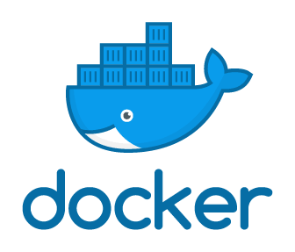


Problem with the last video

Slide 3
Solution in this video

Slide 4
Running Jenkins in Docker

Slide 5
Demo

Slide 6
Thank You

